Slide 1


Q-Learning Reinforcement learning
Florida Atlantic University - CAP 6229 Reinforcement Learning
Shaun Pritchard * Email: spritchard2021@fau.edu * Spring 2022
College of Engineering and Computer Science
Notes:
Welcome to my presentation for CAP 6229 Reinforcement Learning
For those of you who do not know this bright little characters name is Q-bert
Q*bert was an arcade game released around 1982
Like in reinforcement learning Q-bert is an agent whose job is to navigate the digital environment by taking actions and moving through different states by the human user controlling him in order to receive the reward of moving to the next level.

Slide 2
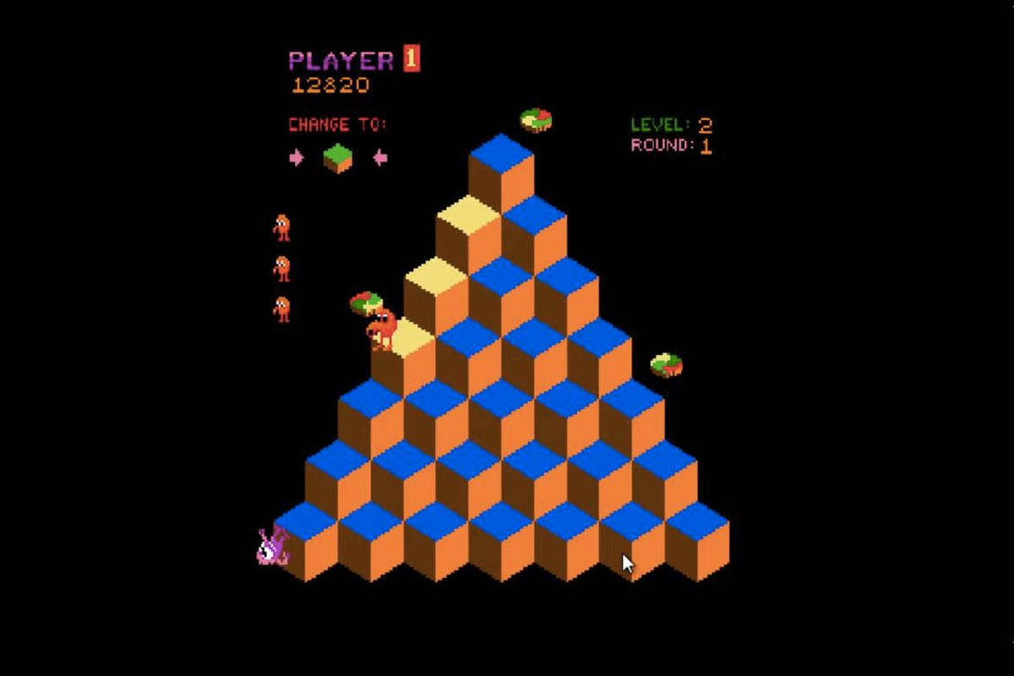
Q-Bert in Q-learning
Notes:
Unfortunately Q-bert ulike Q-learning was navigated through obstacles by human intelligence.

Slide 3
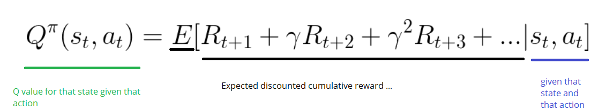
Q-learning
Notes:
Q-learning on the other hand, is considered deterministic in that the reinforcement learning model in that it output is determined solely by the input and initial conditions, thereby always returning the same results.
It also has better cabilbilites for handling real world scenarios for learning environments

Slide 4
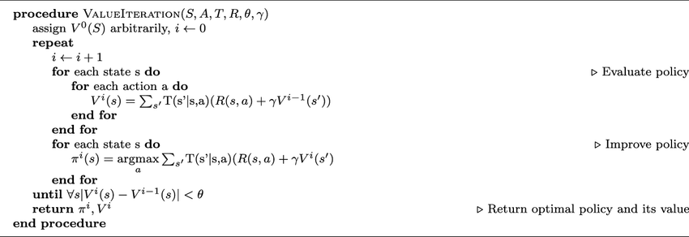
Value Iteration
Notes:
On the other hand, If we look at other methods such as Value iteration which is an iterative algorithm that uses the bellman equation to compute the optimal MDP policy and its value.
We see that It has problems such as:
Policy may converge sooner than values (policy iterations)
Policy extraction is a second step
And assumes perfect knowledge of transition and reward functions
This is not very practical for real world applications

Slide 5
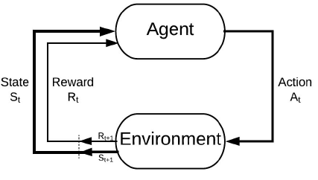
RL Models
Notes:
So in retrospect when we look at reinforcement learning and see that there are 2 main types of RL algorithms models:
A model-free algorithm is an algorithm that estimates the optimal policy without using or estimating the dynamics (transition and reward functions) of the environment.
Whereas, a model-based algorithm is an algorithm that uses the transition function (and the reward function) in order to estimate the optimal policy.
Also just because there is a model of the environment implemented, does not mean that a RL agent is "model-based". To qualify as "model-based", the learning algorithms have to explicitly reference the model:

Slide 6
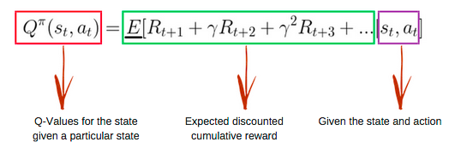
Q-Function
Notes:
Q-learning is a model-free RL algorithm that learns the optimal Markov Decision Process(MDP) policy using Q-values which estimate the “value” of taking an action at a given state.
These values are then inferred to a Q-table for the policy to learn from
The Q-function uses the Bellman equation and takes two inputs: state (s) and action (a).

Slide 7
Q-Learning Algorithm
Initialize Q-Table
Choose an Action
Iteration Results for the Q-Table
Perform Action
Calculate reward
Update Q-Table
Iterate until convergence
Notes:
Follow flow of Q-learning

Slide 8
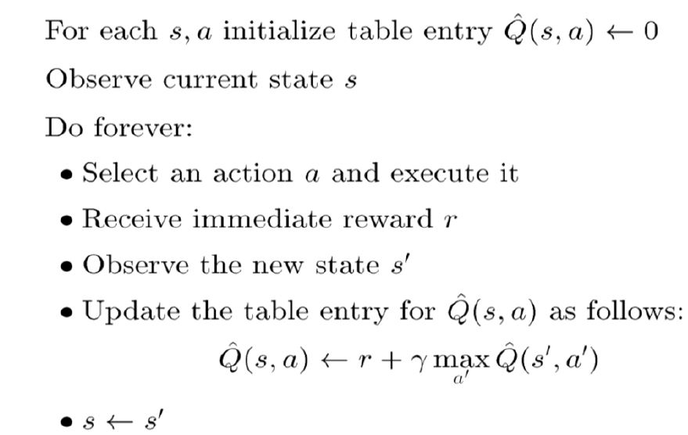
Q-Learning Definition
Notes:
Q-learning Definition
Q*(s,a) is the expected value (cumulative discounted reward) of doing a in state s and then following the optimal policy.
Q-learning uses Temporal Differences(TD) to estimate the value of Q*(s,a). Temporal difference is an agent learning from an environment through episodes with no prior knowledge of the environment.
The agent maintains a table of Q[S, A], where S is the set of states and A is the set of actions.
Q[s, a] represents its current estimate of Q*(s,a)

Slide 9
Q-Learning Basics
Q(s, a) < -Q(s, a) + R+ γ * maxa Q(s', a')
State
Action
Previous
State
Action
Notes:
In a standard Q-learning approach, for every possible state and action, there is a Q-value.
This Q-value represents the utility of an action in a particular state; that is, roughly, the expected future reward R when taking action A in state S.
An agent in a grid world will continuously take actions until it reaches a terminal state, updating its Q-values to the Q-table as it goes. The set of actions taken from the starting state to a terminal state represents an episode.
Q-values are updated throughout an episode as the following algorithm above
Were s is the current state, a is the current action, s′ is the next state, and a′ represents an action from s′, and were γ represents the discount factor for q-values
(1)

Slide 10
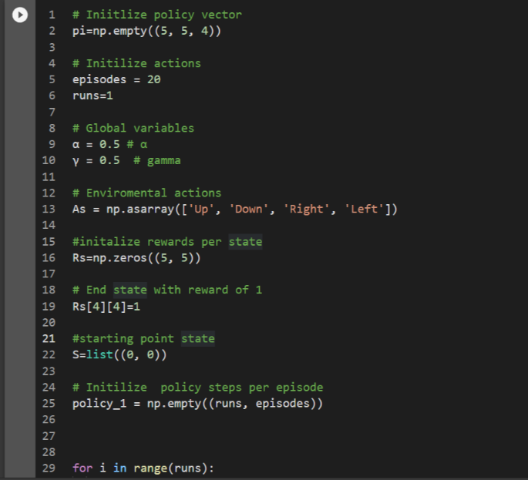
Q-Learning Initialization
Requirements:
5 x 5 grid world
End state of 4 with reward of 1
Alpha = 0.1
Gamma = 0.9
1000 iterations
Notes:
We will use a 5x5 grid world where the starting state is (0, 0) and the end state is (4, 4).
With a learning rate of .1 and and error rate gamma at 0.9 to reach maximum convergence
Here, α∈[0,1] is the step size, based on new evidence from the environment, we will determine how aggressively we should update our estimates parameters.
Q-value is assigned to every possible state or action
It can be thought of as the expected future rewards R of taking action A when in a particular state S; the Q-value thus representing that futuristic reward.
Agents in this grid world continue taking actions until they reach their terminal state, updating their Q-values
I tried altering both the learning rate and error rate and found this to be the best convergence

Slide 11
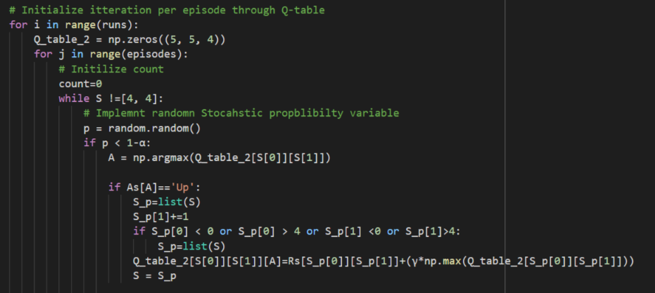
Q-Learning Code
Notes:
Program intilizes with 3 simple loops
The inner loop implements the policy for the stochastic probability updating action s and state
While the outer loop updates the final iteration of the Q table
And the middle loop initializes the count and random actions to implement each episode

Slide 12
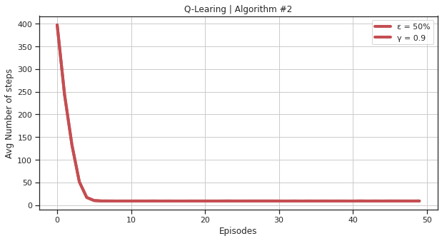
Q-Learning Results
Notes:
From the step-to-goal curve, we can see that with an epsilon of 0.1, by the 7th episode, the agent has learned the optimal policy and the step-to-goal-curve converges. In the first 7 episodes, we can see that the agent is exploring to try and find the optimal policy.

Slide 13
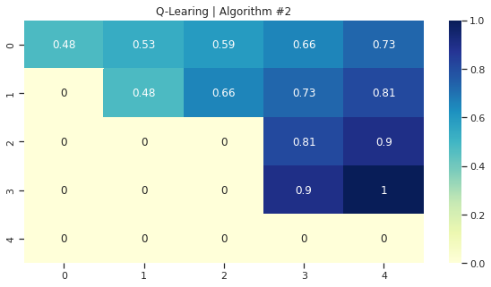
Q-Learning Results
Notes:
From the V-table, we can see that the optimal policy that the agent learned involves moving East 4 times, and North four times, leading to a rough average of 8 steps per episode.

Slide 14
Q-Learning Reinforcement learning
Florida Atlantic University - CAP 6229 Reinforcement Learning
Shaun Pritchard * Email: spritchard2021@fau.edu * Spring 2022
College of Engineering and Computer Science
Notes:
From the V-table, we can see that the optimal policy that the agent learned involves moving East 4 times, and North four times, leading to a rough average of 8 steps per episode.

Slide 15
Q-Learning Reinforcement learning
Florida Atlantic University - CAP 6229 Reinforcement Learning
Shaun Pritchard * Email: spritchard2021@fau.edu * Spring 2022
College of Engineering and Computer Science

